Slide 1

Analytical Minds
Naj Kashyap
Hardik Vaibhav
Team Name- NH

Slide 2


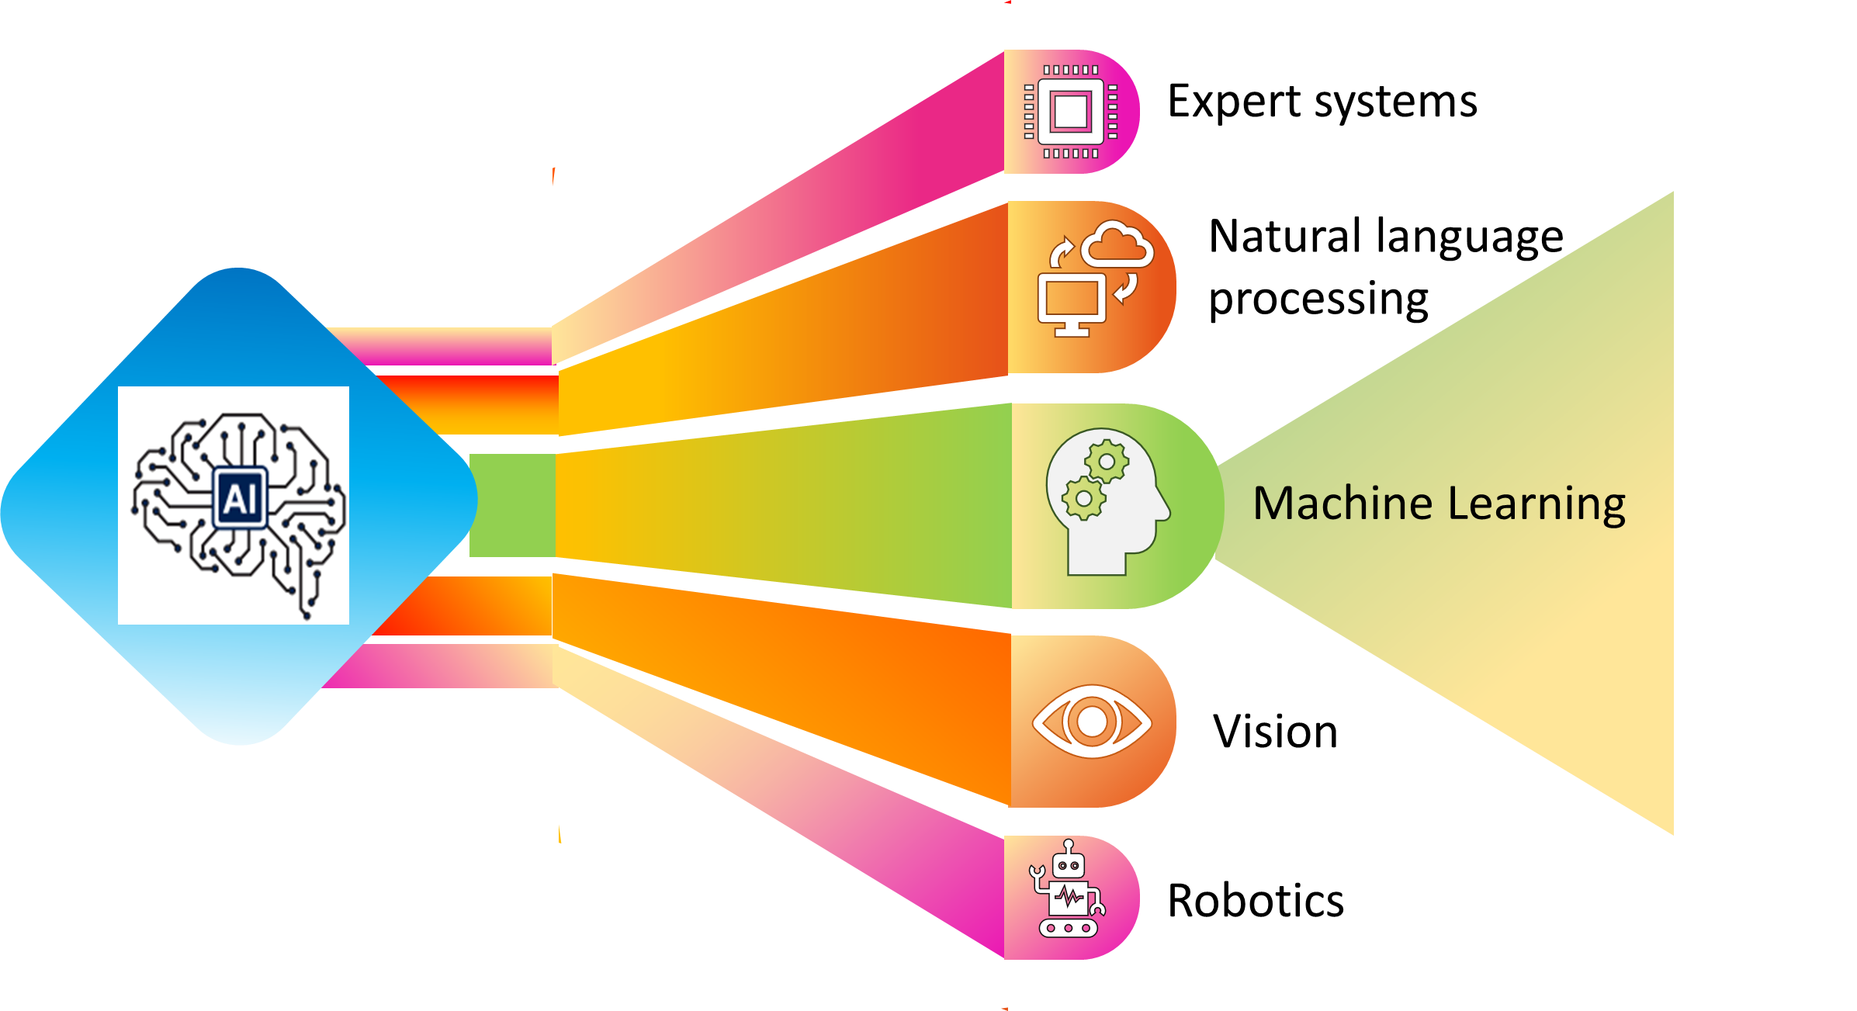


Artificial Intelligence?
(The pursuit of achieving a unified intelligence in machines)
•It develops computer systems for tasks requiring human intelligence like problem-solving and logical thinking.
•It creates intelligent machines that acquire knowledge, analyze data, and make decisions based on patterns.
•AI systems perceive surroundings through sensors and use natural language processing for human interaction, leading to advancements and efficiency improvements.
RPA ?
Streamlining Operations with Robotic
Precision
Machine Learning ?
(Data are fuel and predictions are jewel)
Machine learning develops algorithms for machines to learn from data and make predictions or take actions without explicit programming.
It utilizes statistical techniques and pattern recognition to enhance machine performance over time.
The process involves gathering historical data, constructing logical models, and using them to predict outcomes when presented with new data.
Usually simply rules-based / repetitive / mundane – one that requires the operator to “turn the mangle”
Well-structured activities
Clearly defined rules
Visible and measurable outcomes
Processes should take feeds from well -structured data sources and systems

Slide 3








Cash flow forecasting:
It is a front office operation within the treasury function that falls under the umbrella of cash and liquidity management.
The purpose of cash forecasting
Harris , A leading national mechanical contractor, expert in design and engineering, construction, manufacturing & end-to-end building systems with $600M in revenue & having 900 projects inflowing every month.
The treasury structure in Harris, AR, AP & Payroll were forecasted using different models.
The CFO spends 15+ hours each month on cashflow Forecasting.
Data sourced from ERP & FP&A reports was not insightful.
No use of Variance Analysis to see the difference between Actual & Forecasted cash flows. Manual adjustments is used for modifications to cash forecasting.
Lack of understanding of the future operations position of business
CFO
Accounting
AR
AP
FP&A
Cash Surplus
Cash Deficit
Situation
Plenty of available cash reserve
Interest rate near zero
Focus on business expansion/acquisition
Purpose of Forecasting
Reasonable accuracy
Strategic investment planning through long-term forecasting.
Situation
Utilized most of their revolvers
Delaying payables
Focus on tightly managing cash
Purpose of Forecasting
High accuracy & frequency
Estimate shortage of working capital with short-term forecasting.
Prevent over-borrowing
Project
Manager
With the AI forecasting solution provided by HighRadius , Harris would shift from indirect to direct method of cash forecasting.
AI and ML automate cash flow forecasting, ensuring standardized assumptions and factors, saving time, and providing highly accurate forecasts.
A multi-level procedure enhances forecasting precision, integrating with treasury platforms to determine optimal calculation methods for each category, improving accuracy.
Consideration of multiple influencing factors in forecasting is facilitated by statistical models and machine learning, resulting in more accurate forecasts.
Accurate forecasting relies on analyzing historical data using ML models calibrated to categorize recurring events and filter out outliers for precise projections.
Automatic Aggregation
AP, AR, Billing jobs & Payroll data
AI Cash Forecasting
Automated Forecast for Weekly, Monthly
Variance Analysis with Drill Downs
Enables leadership team to take informed decisions
Results after implementing AI- Enabled solution
Saved over 1 month per person per year for higher value tasks
Accuracy of up to 85% has been achieved in A/R Forecast
Improved short-term visibility for 900+ projects by daily forecasts
Variance Analysis provides insights into various cash flow categories
Utilize all available data to enhance the precision of your forecast.
Attain visibility of cash across various projects.
Automatic Aggregation of bank files

Slide 4
Forecasting cover multiple variables and parameters, with regular review and updates.
Selecting the appropriate model and its optimizaion is crucial.
20 statistical models for forecasting, based on the category and data quality.
We rely on eight model groups, each with unique strengths and weaknesses.
Bayesian Structural Time Series​ | TBATS (ARIMA-based)​ | Neural Networks/ LSTM​ | Support Vector Machine​
Linear Regression Models​ | Robust Linear Regression Models​ | Prophet ​ | XGBoost​
Regression models handle missing data effectively, while ARIMA models struggle with this challenge.
Neural networks excel at pattern identification but require substantial data, which may not be available for monthly forecasts.
Automated analysis of existing data can quickly identify models to reject without the need for further testing.
Like in Harris, HighRadius Rivanna AI Platform relies on Regression and classification done using Decision Trees and Random Forest methods.
Data Landscape
Integration of ERP , TMS, Spreadsheet & data from banks
Like in Harris(Construction firm) uses data given below for forecasting purpose
Balance Sheets​
Income Statements​
Account Receivable & Accounts Payable, Payroll data​
Bank Documents
Data analysis provides a pre-selection of five to six models for testing.
The models are calibrated using identified influencing factors.
A test forecast is generated based on the most recent twelve months of actual historical data.
Deviations between the forecast and actual data from the third year are analyzed for each model.
The best model is selected based on the analysis of deviations.
Influencing factors on company cashflow forecasting
Influencing factors in data create patterns detected by models.
Directly projecting these factors into the future may not always be feasible.
Modeling these factors enhances forecast data quality, improving accuracy and reliability.
GENERAL ​
EXTERNAL​
Public Holidays​
Seasonal effects​
Trends​
SPECIFIC​
EXTERNAL ​ | INTERNAL ​
Economic Indicators​ | Production Planning​
Market Risks​ | Payment Deadlines​
Trade Restrictions ​ | Extraordinary Events​
Consumer Indexes​ | ​

Slide 5






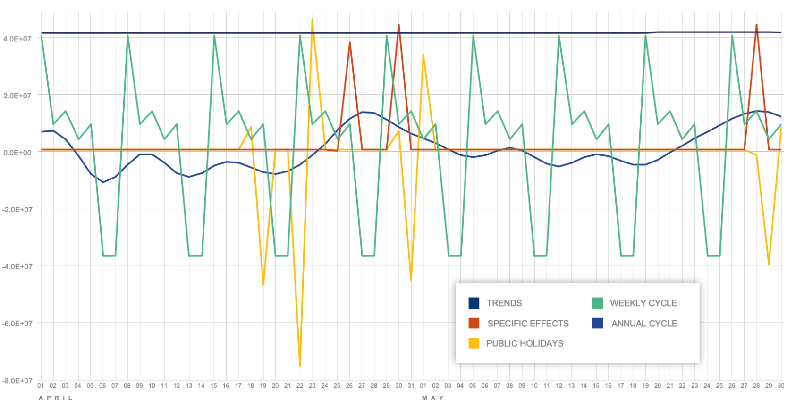
REQUIREMENTS
Analysis of Business Model
Forecasting Categories
Forecast Requirements
DATA BASIS
Identification of data needed & available
Data Import From Upstream systems
DATA ANALYSIS
Analysis of Data Basis
Adjustment for data outliers
Determination & modelling of specific influencing factors
CALLIBRATION
Automatic Determination of Seasonal effects, breaks in Trends & public holiday effects
Consideration of the specific influencing factors & regular specific effects
VALIDATION
Test forecast with every model
Selection of the best model based on least deviation
PREDICTION
Preparation of Forecast
Generation of the model reports with information about the influencing factors/estimated results
An overview of the process: from preparation work to the first forecast: The first step involves tasks which the system later performs itself.
Retrain model with Feedback loop / Ongoing optimization
New data basis
The modeled solution gathers all of the relevant information in a report which is generated along with the forecast data:
Predictions broken down into individual components per influencing factor given in the below graph
The scale and statistical significance of the individual factors
The granulation of seasonal modelling
Identified breaks in trends
The distribution of residuals (estimation errors)
Statistical test results (e.g. heteroscedasticity, autocorrelation, etc.)
Automatic pre-identification of potential outliers
Expected Benefits with AI enabled cash forecasting
The provided information aids treasurers in comprehending the generation of forecast figures, enabling them to identify errors and comprehend the factors behind sudden changes, thereby facilitating transparency and ease of checks.
Optimizing Accuracy of Cash Forecasting
Perform root cause analysis at multiple level
Use the freed up time with automation to work on strategic tasks
Make better debt decisions

Slide 6








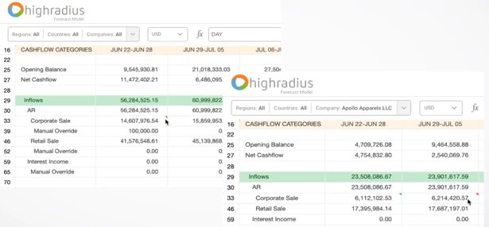
Banks
ERP
Excel
Automated Gathering Data
Connected Workspace
AI Forecast Models
Major challenges in Harris
Treasury Department
Indirect Forecasting method with Low Accuracy | Complex Process was time consuming
Inefficient Data gathering process. Low Visibility into Future Cash Positions | Difficulty in meeting short term objectives using Single forecast horizon
Auto Consolidated Report
Variance Analysis & Key Insights
Automated Forecasting
Impact on Cash flow Forecasting of Harris after AI- Enabled Solution
Scenario Building & Analysis
An overview of the integration and process of AI based cash forecasting cloud of HighRadius :
HighRadius is the solution provider of Harris for the AI enabled cash forecasting cloud
Integration of Forecasts from FP&A teams
AI Based Forecast for Accounts Receivable and Payable
Flexible Models for other operational flows
Configuration of Non-operational Cash flows
Continuous Improvement of Forecasting accuracy
A snap of The future state- Highsheet to manually adjust the cash forecast provided by highradius

Slide 7
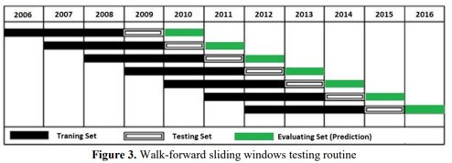
The study uses data from five currency pairs spanning the period ;2006-2016.
The first four-year period (2006-2009) is used to optimize the trading system's parameters.​
The optimized system is applied to the 2010-2016 period using a walk-forward testing approach.
The training window is three years, followed by a one-year testing window and a one-year evaluation set.
Signals produced by the MRB channel strategy during the 2006-2008 period serve as training data for DTs.
Signals from 2009 are used for testing, and the signals produced in 2010 are used for evaluation.
System predicts the profitability of signals in 2010 and then moves forward by one year, repeating the process for subsequent years.
"Enhancing Treasury Management with Real-Time Warning System: Decision Trees in Foreign Exchange Market Analysis“(AIRMS-DT)
Data landscape
This use case introduces the use of machine learning as a risk management tool in the investing field, aiming to enhance trading strategy performance and generate valuable alpha. It focuses on applying decision trees (DT) to classify trading signals as profitable or non-profitable. The analysis will be conducted on five currency pairs(GBP/USD, USD/JPY, EUR/USD, GBP/JPY and EUR/JPY) using a channel breakout trading strategy developed by the authors. The case contributes to the field of expert system applications(ESWA) and has implications for the financial industry.
EWP2:Enhanced Weighted Portfolio 2, an improved version of a weighted portfolio strategy for forex trading, incorporating specific enhancements and criteria for assigning weights to different currency pairs.
KCP2:Enhanced Kelly Criterion Portfolio 2, an advanced version of the Kelly criterion portfolio strategy specifically designed for forex trading. It utilizes the Kelly criterion to determine the optimal allocation of capital among forex trades, incorporating enhancements or modifications to enhance performance and account for expected returns and risks.
The objective is to enhance the performance of the EWP2 and KCP2 portfolios.
reduction of their standard deviation
amelioration of the correlation between their total return and the portfolios’ standard deviation
Data processing for DT model
The data is divided into overlapping training-testing-validation sets.
This approach aims to mimic real-life trading and assess the model's robustness.
Frequent retraining is performed on a large out-of-sample dataset.
The size of the validation set determines the frequency of retraining.
Walk-forward testing allows the decision tree to adapt to changing market conditions.
Machine learning techniques in this use case follow a dynamic sliding window approach in a training-testing-evaluation procedure.

Slide 8
ML models use input features to classify trading signals as either winning or losing trades. The goal is to assist investors in identifying profitable signals by combining multiple input features to predict the outcome of trading signals.
Result of AIRMS DT : A risk management tool for FX Exchange Market Analysis of the 5-currency pair.
GBP/USD
AIRMS DT outperforms the MRB strategy in returns for 6 out of 7 years, largest improvement in 2010.
The return increased by almost 645% from -2.97% to 16.21%
The AIRMS strategy achieves a total return of 111.42%, surpassing the MRB strategy by 118% and demonstrating reduced fluctuations.
USD/JPY
AIRMS DT outperforms the MRB strategy in returns of 6 out of 7 years, largest improvement in 2011, where AIRMS improves the return by 104%.
AIRMS DT reduces the standard deviation of returns by 10% between 2010-2016.
AIRMS achieves a total return of 123.18%, improving the return by 64.55%.
EUR/USD
AIRMS DT outperforms the MRB strategy in returns of 6 out of 7 years, largest improvement in 2011
AIRMS DT improves the return by 1500%.
AIRMS DT reduces the standard deviation of returns by 10% .
AIRMS achieves a total return of 194.28%improving the return by 24.70% .
GBP/JPY
AIRMS DT outperforms the MRB strategy in returns of 5 out of 7 years, largest improvement in 2016
ARIMS DT Improves the return by 53.28%
AIRMS achieves a total return of 240.54% improving the return by 10.55% .
EUR/JPY
ARIMS Improves the return by 176%.
AIRMS DT outperforms the MRB strategy in returns of 5 out of 7 years, largest improvement in 2013
AIRMS achieves a total return of 240.54% improving the return by 10.55% .
The AIRMS strategy achieves a total return of 273.59%, surpassing the MRB strategy by 31% and demonstrating reduced fluctuations.
The features based on technical indicators that are used in this case are:
(i) Cross of simple moving average of the last 200 bars and simple average of the last 100 bars (one feature),
(ii) Cross of simple moving average of the last 50 bars and simple average of the last 25 bars (one feature),
(iii) Relative strength index of the last 14 MRB (one feature), (iv) Acceleration between 12 last bars (one feature),
(v) Moving average convergence/divergence (MACD) (one feature),
(vi) Stochastic oscillator (one features),
(vii) Momentum of the 12 last MRB (one features),
(viii) Bollinger band (two features; upper, lower and middle band),
(ix) Weighted close price (one feature),
(x) Price rate of change of the close price of the last 12 bars (one feature),
(xi) High and low channel of the last Y MRB (two features).
Evaluation Metric:
The evaluation matric for our AIRMS DT algorithm is F1 score
High F1 score means high precision(P) and recall(R) for the model. Predictions about the winning trades are usually correct
Good F1 : means model predicts correctly most of the winning trade not polluted by many loosing ones.
Key Observations:
The risk management system based on DT successfully improved negative returns and reduced the standard deviation of each currency pair.
AIRMS-DT prevented significant drawdowns in the original trading strategy, enhancing stability for investors.
The system also improved the total return for all currency pairs, demonstrating its capability to consistently generate high profits.
These observations highlight the stable predictive ability of the DT-based AIRMS, resulting in reduced fluctuations and increased profitability.

Slide 9
No. Of Signals​​ | Profit/Loss (pips)​​ | Prediction Without AIRMS​​ | Prediction With​​ AIRMS-DT​​ | Result Without ARIMS​​ (pips)​​ | Results with AIRMS-DT​​
1​​ | (28.40)​​ | 1​​ | -1​​ | (28.40)​​ | 0.00​​
2​​ | (48.00)​​ | 1​​ | -1​​ | (48.00)​​ | 0.00​​
3​​ | 143.40​​ | 1​​ | 1​​ | 143.40​​ | 143.40​​
4​​ | 53.60​​ | 1​​ | 1​​ | 53.60​​ | 53.60​​
5​​ | 153.50​​ | 1​​ | 1​​ | 153.50​​ | 153.50​​
6​​ | (15.60)​​ | 1​​ | -1​​ | (15.60)​​ | 0.00​​
Reference :
AIRMS: A risk Management tool using machine learning
Predictions of AIRMS-DT :2010 in GBP/USD signal "1" indicating profitable signals that result in trades and "-1" indicating non-profitable signals that are ignored. The total return for each AIRMS is calculated based on these trades. The "Without AIRMS" column represents the original MRB trading strategy where all signals are traded.
Total Return​ | Compound Growth (%)​ | Arithmetic Average (%)​ | Geometric Return (%)​ | Standard Deviation (%)​ | Sharpe Ratio​
220.14 | 621.46​ | 31.44​ | 29.82​ | 19.70​ | 1.47​
Evaluation metrices for KCP-DT
Total Return​ | Compound Growth (%)​ | Arithmetic Average (%)​ | Geometric Return (%)​ | Standard Deviation (%)​ | Sharpe Ratio​
178.35 | 621.46​ | 31.44​ | 29.82​ | 19.70​ | 1.47​
Evaluation metrices for KCP2

Slide 10
Years​​ | 2010​​ | 2011​​ | 2012​​ | 2013​​ | 2014​​ | 2015​​ | 2016​​
EWP-DT Returns(in %)​​ | 42.18 | 21.55​​ | 32.24​​ | 3.21​​ | 47.07​​ | (8.69)​​ | 51.04​​
Equally Weighted Portfolio based on AIRMS-DT (EWP-DT)
Years​ | 2010​ | 2011​ | 2012​ | 2013​ | 2014​ | 2015​ | 2016​
EWP2 Return((in %)​ | 32.54​ | 7.83​ | 28.44​ | (4.65)​ | 40.68​ | (8.32)​ | 45.09​
Equally Weighted Portfolio without any AIRMS (EWP2)
Total Return​ | Compound Growth (%)​ | Arithmetic Average (%)​ | Geometric Return (%)​ | Standard Deviation (%)​ | Sharpe Ratio​
188.60​ | 478.43​ | 26.94​ | 25.06​ | 21.07​ | 1.16​
Evaluation metrices of EWP-DT
Total Return​ | Compound Growth (%)​ | Arithmetic Average (%)​ | Geometric Return (%)​ | Standard Deviation (%)​ | Sharpe Ratio​
141.61​ | 327.53​ | 20.23​ | 18.47​ | 21.77​ | 0.83​
Evaluation Metrices of EWP2
Years​ | 2010​ | 2011​ | 2012​ | 2013​ | 2014​ | 2015​ | 2016​
KCP-DT Returns(in %)​ | 41.60​ | 32.73​ | 43.20​ | 8.03​ | 51.64​ | (4.21)​ | 47.14​
Kelly Criterion Portfolio based on AIRMS-DT (KCP-DT)
Years​ | 2010​ | 2011​ | 2012​ | 2013​ | 2014​ | 2015​ | 2016​
KCP2 Returns(in %)​ | 33.02​ | 18.30​ | 44.13​ | 1.99​ | 43.99​ | (4.47)​ | 41.39​
Kelly Criterion Portfolio without any AIRMS (KCP2)

Slide 11
ChatGPT
The release of ChatGPT in late 2022 created a groundswell of interest in generative AI. Within a few hours of exploring this novel technology, users quickly identified & exchanged a wide range of productivity tricks & tips. In the subsequent weeks & months, organizations have been striving to catch up & adapt swiftly, all while safeguarding themselves against unexpected complications. AI has never been so accessible. Tools like ChatGPT, DALL-E 2, Midjourney, and Stable diffusion offer boundless opportunities for individuals to develop websites, devise advertising tactics & managing treasuries.
ChatGPT & other Generative AI models have also proved useful for treasury professionals seeking to expand their data driven capabilities & knowledge. Treasury is an ever-evolving field as technology & economic conditions change.
​In small companies, with a natural language processing-optimized user experience (UX), TMS is more precisely addressing fundamental queries, such as:​
“Display global bank balances converted to USD”​
“What is my exposure to Yen?”​
​
More intricate inquiries like ​
“What factors contributed to the variance in my forecast last week?” ​
“How many days of liquidity remain for us?” ​

Slide 12
Examples
Kyriba, a global leader in cloud treasury & finance solutions has tested on utilizing ChatGPT & similar generative AI tools for enhancing bank reconciliation. In depth, these advanced AI tools have been designed to identify disparities between forecasted & actual transactions, enabling automatic reconciliation of transactions. This automation process replaces manual processing that would typically occur within the cash management module of any Treasury Management System (TMS).
Trovata, a fintech company specializing in cloud-based solutions for treasury management. It offers a TMS designed to assist businesses in automating & streamlining their treasury operations. On May 3, 2023, it announced the first generative AI entrant in fintech space.
Trovata AI leveraged OpenAI’s ChatGPT technology to accelerate the company’s visions which encompasses:
· Automating cash workflows
· Business intelligence for corporate finance, accounting, & treasury departments.
On March 30, 2023, Bloomberg released a research paper detailing the development of BloombergGPTTM, a new large-scale generative AI Model (ChatGPT). On a broad scale, this large language model (LLM) is particularly trained on a wide range of financial data which supports diverse set of NLP tasks within financial industry.
To be quite specific, Bloomberg is enhancing the client experience by offering a user-friendly solution for monitoring:
· Investment portfolios
· Obtaining answers to critical financial queries
· Supporting investors in making informed & straightforward financial decisions.
The emergence of technologies like ChatGPT and AI is revolutionizing the work of treasury professionals are as follows:
· Transforming their approach to tasks
· Decision-making
· Communication & Collaboration
· Risk management.
It is crucial for treasury professionals to embrace these advancements and for treasury leaders to make informed decisions regarding the adoption of treasury technologies that align with their goals and objectives.
Recent developments demonstrate the emergence of a new era in B2B, where AI-powered solutions in the form of SAS models are revolutionizing treasury management. These advanced technological solutions enable organizations to address their business challenges with greater efficiency and effectiveness.

Slide 13

"Reliance's Treasury Advancement: Embracing Technology and Efficient Management"
Scenario in FY 15
Reliance has demonstrated remarkable success in enhancing its business and profitability by prioritizing and investing in treasury management and operations not once, but twice.
Reliance Industries witnessed a significant increase of nearly 50% in its current investment, amounting to Rs 51,014 crore, during the fiscal year 2014-15.The purpose of this increased investment was to enhance its treasury income. However, during the same period, Reliance Industries experienced a substantial decrease in its cash and bank balance, which depleted by 67% to Rs 12,545 crore. These figures are based on the information provided in Reliance Industries' annual report.
The current data indicates a shift towards a more assertive strategy in treasury operations aimed at achieving improved returns. Previously, Reliance Industries adopted a cautious approach by maintaining a significant portion of its surplus as cash and bank balances, prioritizing liquidity management over higher returns. However, the current investment now exceeds the cash and bank balance by more than four times, suggesting a more aggressive approach focused on maximizing returns.
"When economic conditions are bad and the realization from core businesses are stressed, the company is trying to maximize return on its capital through aggressive treasury operations,"
G Chokkalingam
Founder and managing director, Equinomics Research and Advisory.
It is evident that treasury operations have gained significant prominence for Reliance Industries, surpassing the contribution of core areas such as petrochemicals, oil and gas, and retail to the company's earnings.
In FY15, Reliance Industries earned Rs 8,335 crore from its treasury operations.
The EBIT (earnings before interest and tax) from refining, oil and gas, and retail were lower in comparison.
The EBIT from the refining business was the highest at Rs 13,392 crore.
The EBIT from refining, oil and gas, and retail were Rs 13,392 crore, Rs 3,181 crore, and Rs 417 crore, respectively, in FY15.
According to data from Capitaline, the company provided an 11.5% return in 2013-14.
During the same period, the yield from the company's treasury was 9.4%.
In 2014-15, the company maintained a treasury yield of 9.4%.
This was calculated on interest income, profit on sale of investments, and dividend income, at an average investment and cash and bank balance for the two preceding financial years

Slide 14
During the annual general meeting (AGM) held on August 12, 2019, Ambani made the following statement: “We have a very clear roadmap to becoming a zero net-debt company within the next 18 months, that is by 31 March 2021.”
The company then went on to announce a capital raise worth US$20bn and the completion of a US$7bn rights issue “completed entirely on a digital platform during lockdown”.
On June 20, 2020, Ambani announced in a statement submitted to the Bombay Stock Exchange (BSE) that RIL had achieved a net debt-free status, surpassing the March 2021 deadline by nine months.
One of the prominent persons involved in this mission was Mr. Soumyo Dutta, Group Treasurer. He has explained the Treasury operations of Reliance as structurally, Reliance Industries has treasuries embedded within each of its business divisions; there is a treasury for the refining business, one for the petrochemical business, one for the consumer business and so on. The role of the central treasury, he suggests, is to “lay down the broad boundaries, frameworks and priorities, and define how each individual treasury should interact with our banking partners.”
The company uses SAP as its enterprise resource planning system and Murex for treasury and financial markets, working with the providers to ensure there are linkages and interoperability between the two.
Scenario in FY 19
Mr. Mukesh Ambani
Chairman &MD of Reliance
Reliance has capitalized on its organic growth in downstream capacity within the energy sector, presenting an opportunity to explore a wide array of trade finance instruments for both the capital and trade account. The treasury team members have been extensively engaged throughout the company, utilizing various financing tools such as buyer's credit, seller's credit, forfaiting, and different forms of supply chain finance to meet their financing needs. Reliance has consistently relied on export credit agency-backed (ECA) financing as its primary source of long-term funding.
Dutta characterizes Reliance as "the world's largest user of ECA financing," engaging with ECAs from Japan, South Korea, Italy, and other countries.
ECA financing, known for its extended repayment periods, proves advantageous for substantial projects with considerable development timelines. Reliance Industries exemplifies this through its telecommunications venture. In September 2019, Jio Platforms, a subsidiary of Reliance Industries, secured a 10-year loan worth US$1 billion, supported by Korean trade insurer K-Sure. The funding aimed to facilitate the expansion of India's 4G wireless network by financing the acquisition of goods and services.
According to Mr. Soumyo Dutta , the Reliance Treasury aims to transform into a centralized, platform-based entity. This reorganization would enable users from different areas of the business to efficiently and promptly request various treasury services, including working capital raises, long-term funding raises, and FX risk hedging.
Mr. Soumyo Dutta
Group Treasurer, Reliance Industries Ltd.
“We are always looking to new ideas and when it comes to our treasury set-up, the ‘blue-sky thinking’ centres on whether our treasury can be designed as a platform organisation.”

Slide 15

Thank you

